Slide 1
Gigabit Rate Multiple-Pattern Matching with TCAM
Fang Yu Randy H. Katz
{fyu,randy}@eecs.berkeley.edu
T. V. Lakshman
lakshman@research.bell-labs.com

Slide 2
Outline
Pattern matching is a crucial component of network intrusion detection system
  Thousands of patterns
  Require high rate (e.g. gigabit)
  Current software based pattern matching algorithms is not sufficient
Use Ternary Content Addressable Memory (TCAM) for fast pattern matching
  Straight-forward solution
  Support for long patterns, patterns with correlations, and patterns with negation
  Speedup to multi-gigabit rate

Slide 3
Pattern Matching
Single pattern matching
  Given an input string P and a pattern string T, whether T appears in P?
Multiple-pattern matching
  Given an input string P and a set of pattern strings T₁, T₂, …T_{m}, whether any T_{i} appear in P?

Slide 4
Applications of Pattern Matching
Anti-virus software
Bio-informatics: searching for gene patterns
Intrusion detection system (E.g. Snort, Bro )
  Thousands of patterns
  Patterns with correlations
    “abc” followed by “cde” within 3 bytes
  Patterns with negation
    “user” not followed by “|0a|” within 10 bytes
  Gigabit scan rate

Slide 5
Current Pattern Matching Algorithms
Boyer-Moore
  For single pattern matching
  Number of comparisons is linear to the input string length
Aho-Corasick
  Build finite automaton for multiple pattern matching
  linear number of comparisons
  Cons:
    Need to compile every time new patterns are added or deleted
    Large automaton (>1G) may not fit in fast memory (SRAM)
Set-wise Boyer-Moore
  Restore the reverse pattern in a trie for multiple pattern matching
  linear number of comparisons
  Similar cons as Aho-corasick

Slide 6
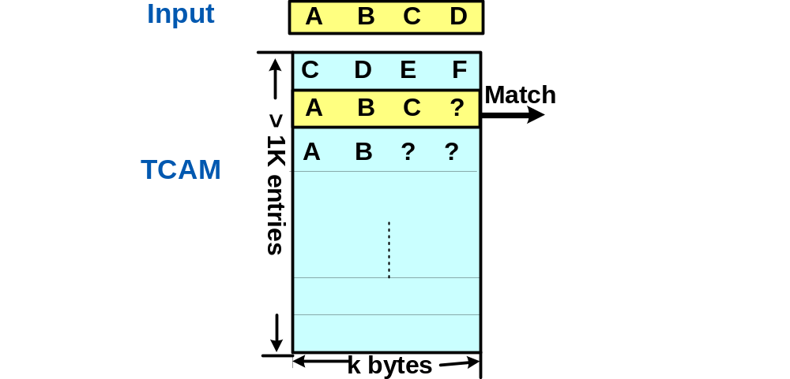
Ternary-CAM (TCAM)
Each cell takes three logic states
  ‘0’, ‘1’, and ‘?’(don’t care)
Fully associative memory: compares input string with all the entries in parallel
  If multiple matches, report index of the first match
Current TCAM technology
  Fast Match Time: 4-8 ns
  Size: 1M
    1K entries * 1K bytes per entry
    2K entries * 512 bytes per entry

Slide 7
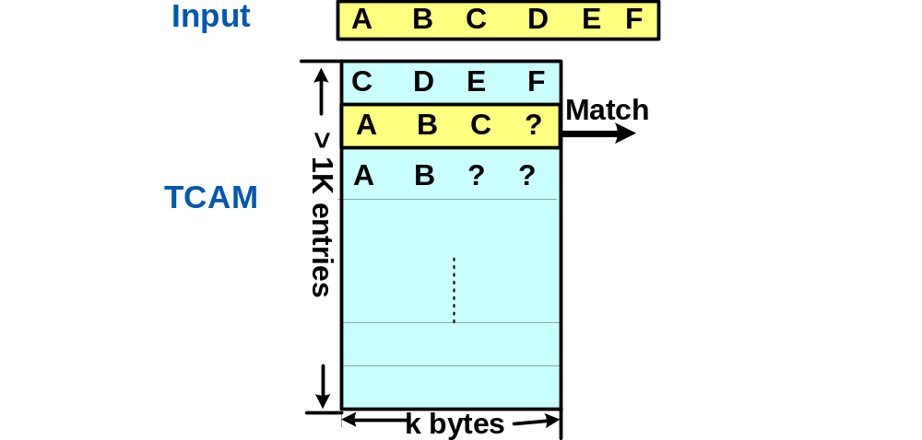
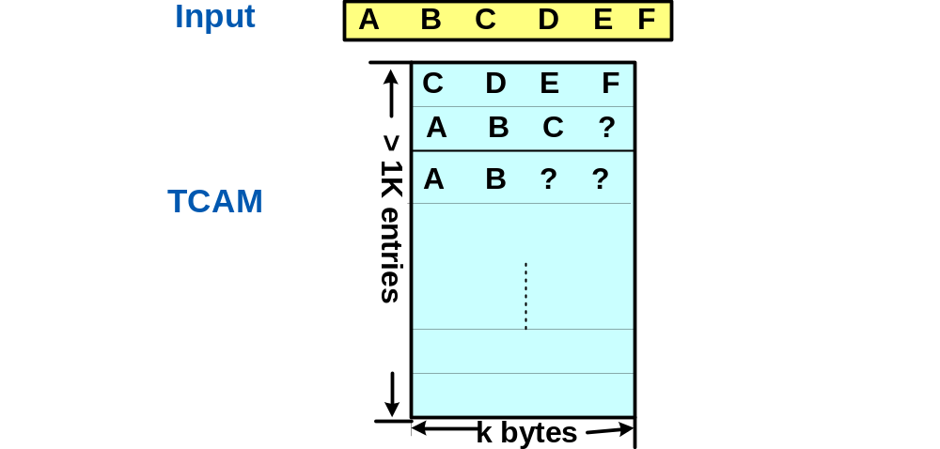
Pattern Matching with TCAM
Put all the patterns into the TCAM
  Assume patterns are less or equal to TCAM width
  If shorter than TCAM width, pad with ‘?’
  Order the patterns according reverse lengths
    When matching entry ABC, report matching of both pattern ABC and AB
Shift one byte each time

Slide 8
Analysis
Scan speed:
  4-8 ns per TCAM lookup, shift one byte at a time
  1-2 Gbps worst case scan rate
Able to report occurrences of all the patterns in the input string
Limitation: require all the patterns to be shorter or equal than the TCAM width

Slide 9
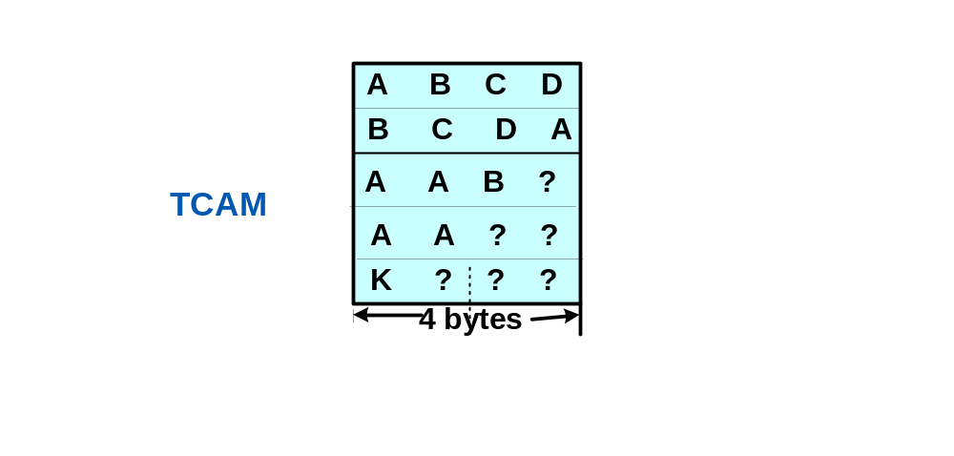
Long Patterns
What if pattern is longer than the width of TCAM?
Split it into multiple partial patterns
For example, TCAM width k=4
Pattern index | Pattern content
1 | ABCDAA
2 | BCDAK
3 | BCDAAAB

Slide 10
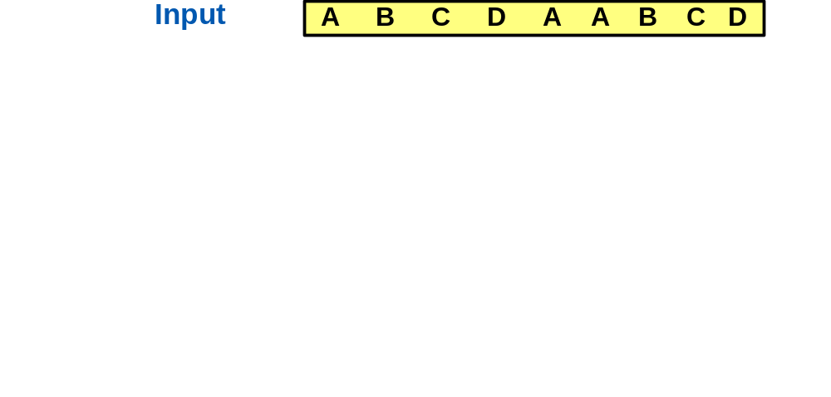
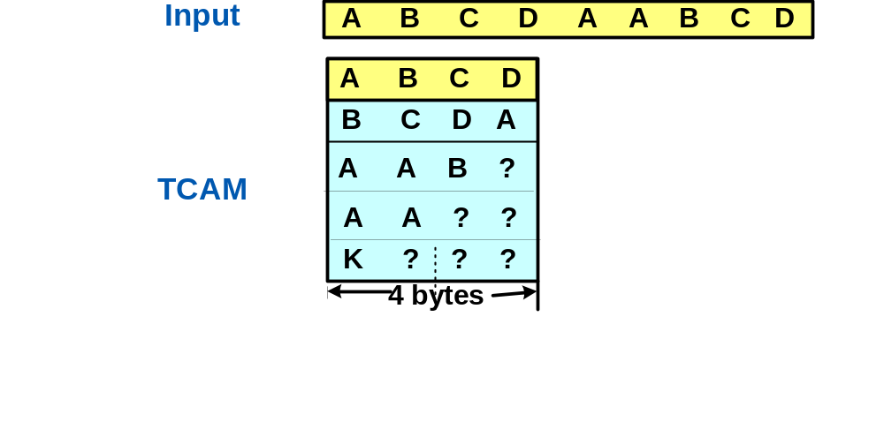
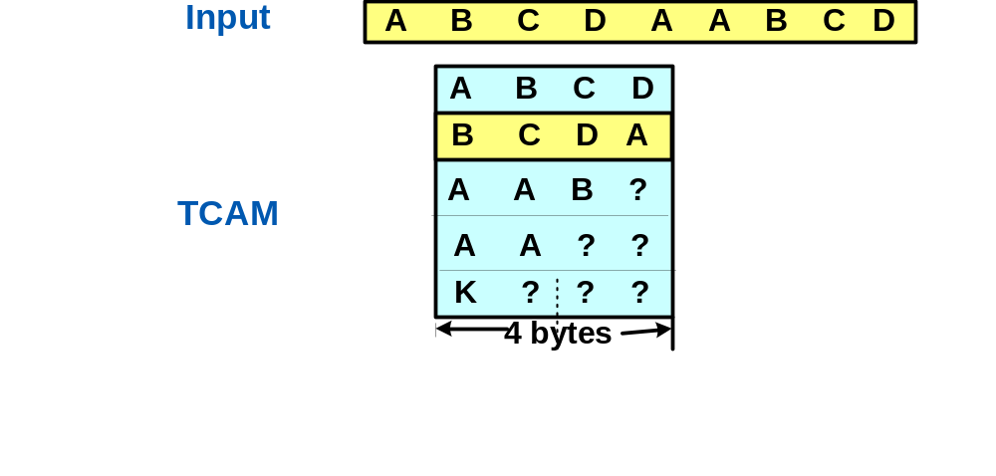
Partial Hit list for Long Patterns
Use a table to store the partial hit pattern
  Keep matches at previous k positions
Partial Hit List
Position | Matched entry
[1,4] | ABCD
Position | Matched entry
Position | Matched entry
[1,4] | ABCD
[2,5] | BCDA

Slide 11
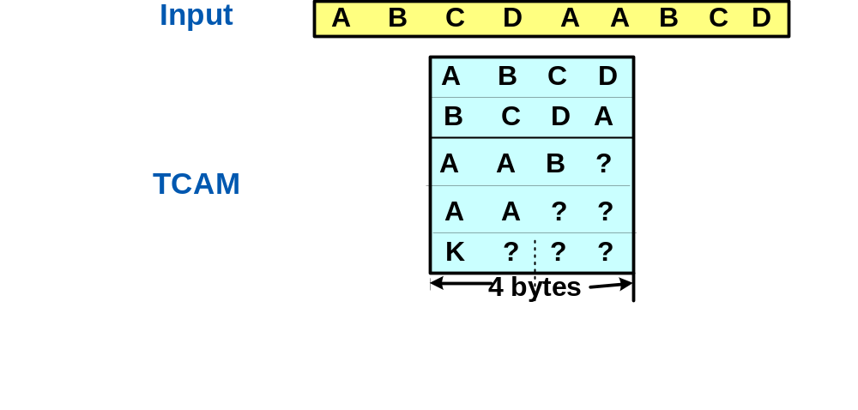
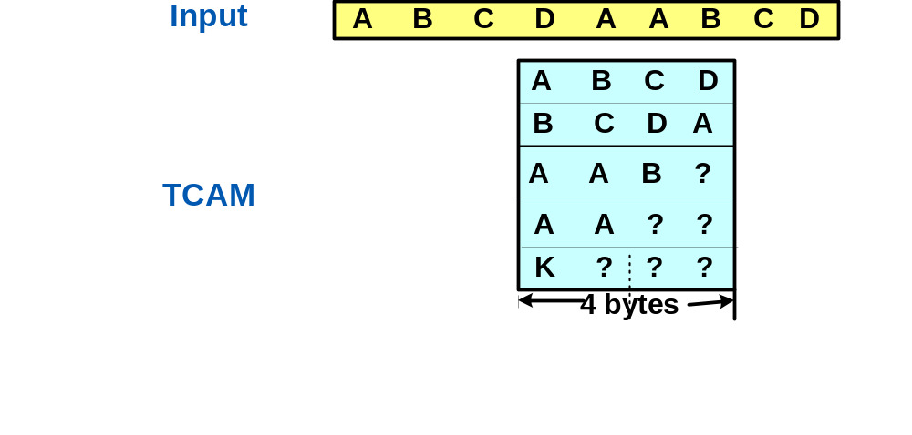
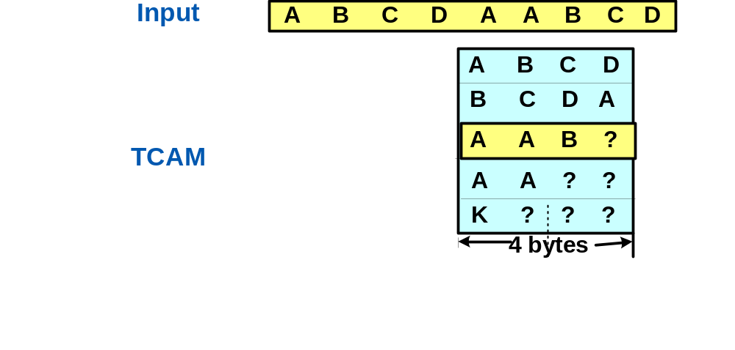
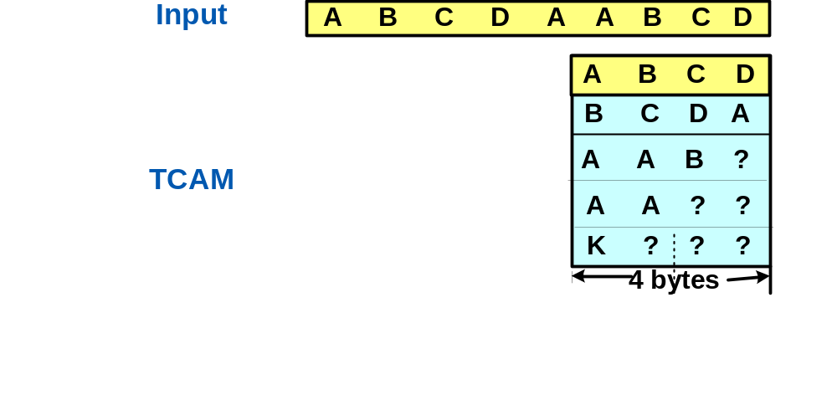
Concatenate Partial Patterns into Long Patterns
Partial Hit List
When finding another pattern at position [i, i+k-1],
  Check the combination with match at [i-k, i-1]
Patterns:
ABCDAA, BCDAK, BCDAAAB
Position | Matched entry
[1,4] | ABCD
Position | Matched entry
Position | Matched entry
[2,5] | BCDA
Position | Matched entry
[6,9] | ABCD
Matching Table
First Match | Second Match | Matching pattern
ABCD | ABCD | No match
ABCD | BCDA | No match
ABCD | AAB? | ABCDAA
ABCD | AA?? | ABCDAA
BCDA | ABCD | No match

Slide 12
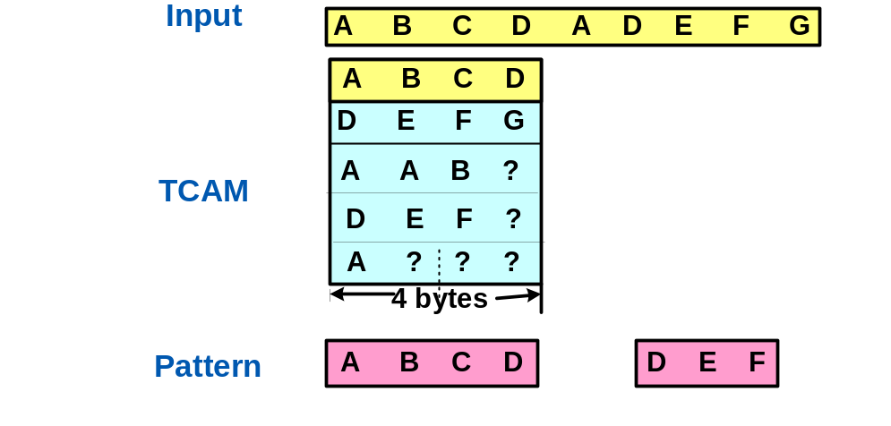
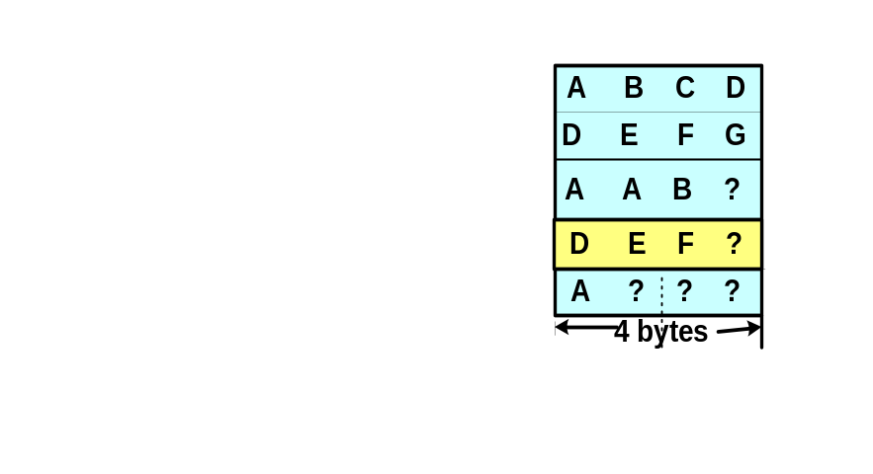
Correlated Patterns
Correlated patterns: one pattern after another pattern
  E.g. “ABCD” followed by “DEF” within 4 bytes
Similar to long patterns
  The distance between two partial patterns for long pattern is = k
  The distance between correlated pattern >= 1
  If find pattern matching at position [i, i+k],
    Need to check all the previous matches in the partial hit list
    If partial hit list is large➔ problem!
Partial Hit List
Position | Matched Entry
[1,4] | ABCD

Slide 13
Patterns with Negation
In snort rule set, there are following rules:
  content : "USER" ; content : !"|0a|" ; within : 50 ;
Similar to regular correlated patterns
  When matching “USER”, add it to partial list
  When matching "|0a|" , remove “USER” from partial list
  If no match of "|0a|" in 50 bytes, report hit of full pattern
Need to maintain a lifetime for entries in partial list

Slide 14
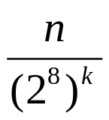
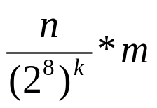
Statistical Analysis of Partial Hit Table Size
Assume random input string, random independent patterns
Parameters
  Input string size: m bytes
  Number of patterns: n
  Pattern size: k bytes
Chances of a matching at position [0, k-1] is
There are at most m positions, so average hit is
Suppose an bad case: m = 2^10, n=2^11, k=3, then average hit is 2^-3 ➔ Partial hit list table size<1

Slide 15
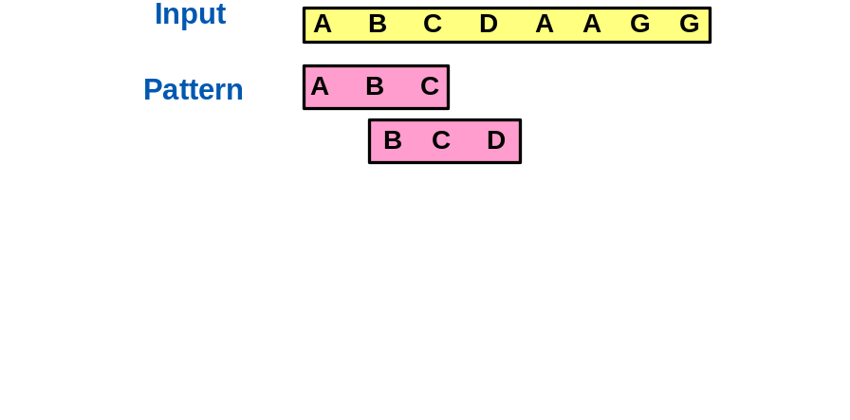

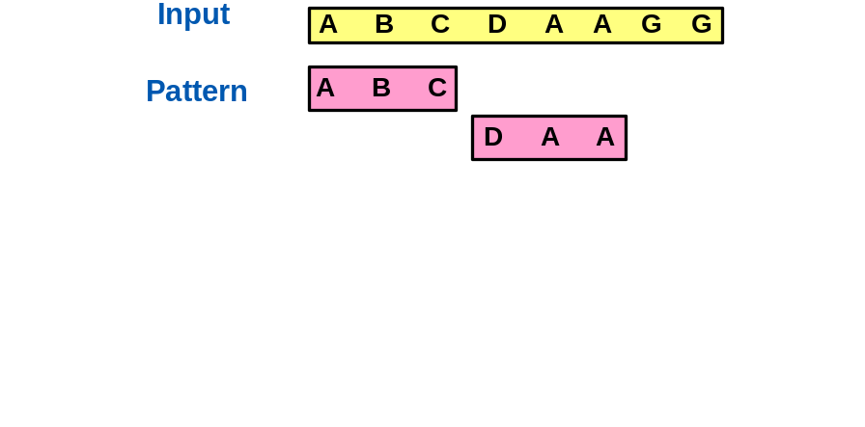
Malicious Attack?
Any made-up input string can match one pattern at position [i, i+k] and another at position [i+j, i+k+j] ?
  When j = 1, probability is:
  ➔ low when k>4
  When j increases, the probability increases. If j=k, then probability =1
To protect against malicious attack, we want to limit the size of partial hit list
  Window: limit the distance between two correlated patterns
  On-going research

Slide 16
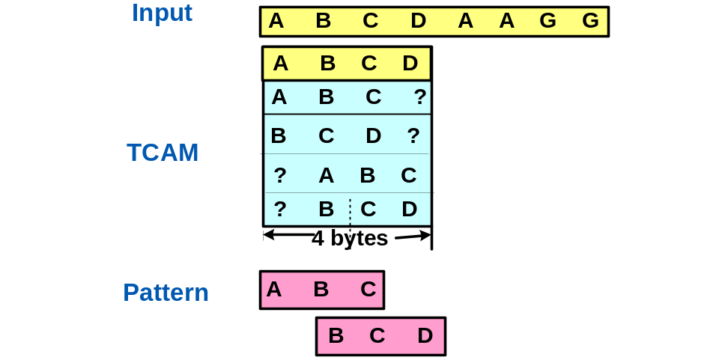
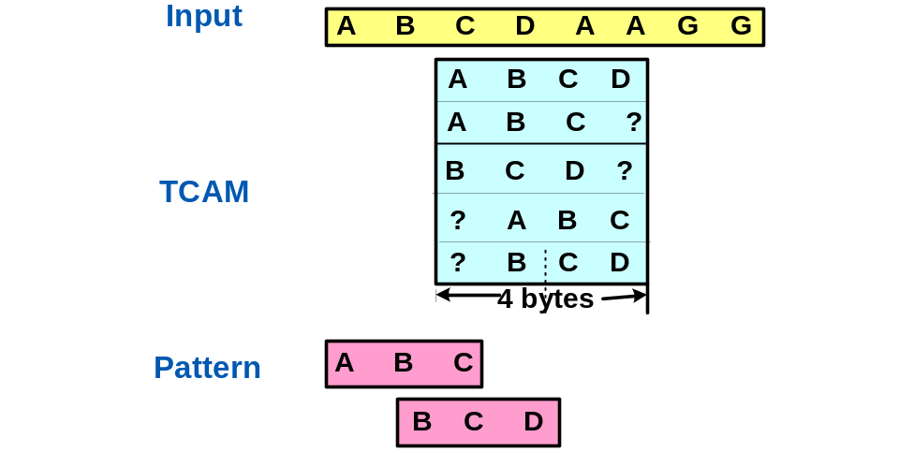
Speed up to Multi-gigabit Rate
Instead of shift one byte at a time, shift s bytes each time
  Put each pattern s times in the TCAM at different positions
  Need to put extra entry (ABCD) for overlapped pattern: ABC and BCD.
Analysis for speed up of s times
  Roughly s times original TCAM entries
    Overlapped patterns are few
    when pattern length k is large
  Matching table kept in memory is
  s² original size
  More patterns cut into partial patterns
  Suggest s to be small (e.g. <=5)

Slide 17
Conclusion and Future Work
Multiple pattern matching with TCAM can:
  Support all the pattern matching in Snort
    Search for thousands patterns in parallel
    Support long patterns, correlated patterns, and also patterns with negation
    Can report all the occurrences of all the patterns in the input string
    Can’t do other function like byte jump, byte test etc
  Bring Anti-virus scan speed to gigabit rate
Initial analytical results will be shown in poster session
Future work
  Analyze on the cost of insertion and deletion of patterns
  Further analysis on the partial list hit window size
  Further extensive simulation to test the scheme

Slide 18
Backup Slides

Slide 19
Memory Technology (2003-04)
Technology | Single chip density | $/chip ($/MByte) | Access speed | Watts/chip
Networking DRAM | 64 MB | $30-$50 ($0.50-$0.75) | 40-80ns | 0.5-2W
SRAM | 4 MB | $20-$30 ($5-$8) | 4-8ns | 1-3W
TCAM | 1 MB | $200-$250 ($200-$250) | 4-8ns | 15-30W
Note: Price, speed and power are manufacturer and market dependent.
Pankaj Gupta, “Address Lookup and Classification”
Notes:
This is probably a good time for me to make a note. Throughout this lecture and next, you will find an almost continuous flip-flop between algorithmic analysis and real-world constraints. This is probably due to a lot of research in this field being done at the same time when industry was and is designing prcticl solutions. Hence, I think they have influenced each other heavily. That may be good or bad depending on one’s ambitions.

Slide 20
Software Based Algorithm v.s. TCAM
Suppose 2K patterns, average of 16 bytes
Software Based Algorithm using DFA
  O(2K*16) = O(2^15) states
  2^8 next byte possibility
  O(2^23) entries, each entry O(log(2^15))= 2Bytes ➔ 16M memory
    Won’t fit in fast SRAM
    If put in DRAM, max throughput is 200Mbps
TCAM approach
  2K*16 = 32K bytes

